Slide 1
Project Management
“Introduction to Project Management: Tools, Techniques, and Practices”
BA 320 Operations Management

Slide 2
Projects versus Operations
Organizations perform work - either
  Operations, or
  Projects
Shared characteristics of projects and operations
  Performed by people
  Constrained by limited resources
  Planned, executed and controlled

Slide 3
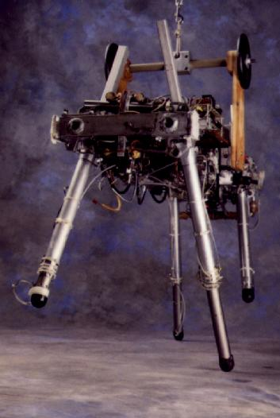


Slide 4
Operations and projects differ:
Operations are ongoing and repetitive
Projects are temporary and unique
“A project is a temporary endeavor undertaken to create a unique product or service.”
  temporary - definite beginning and end
  unique - different in some distinguishing characteristic

Slide 5
Examples of projects
Developing a new product or service
Effecting a change in structure, staffing, or style of an organization
Designing a new transportation vehicle
Constructing a building or facility
Running a campaign for political office
Implementing a new business procedure or process

Slide 6
What is Project Management?
Project management is the application of knowledge, skills, tools, and techniques to project activities in order to meet or exceed stakeholder needs and expectations from a project.

Slide 7
The project management challenge
Meeting or exceeding stakeholder needs and expectations invariably involves balancing competing demands among:
Scope, time, cost, and quality
Stakeholders with differing needs and expectations
Identified needs and unidentified expectations - “client relations challenge”

Slide 8
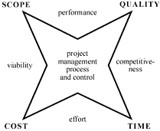
The core of project management
published by PMI in 1987

Slide 9
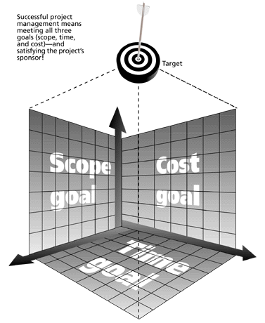
Where most projects fail

Slide 10
Project Management Knowledge Areas (PMBOK)
Scope Management
Cost Management
Communications Management
Human Resources Management
Time Management
Quality Management
Risk Management
Procurement Management

Slide 11
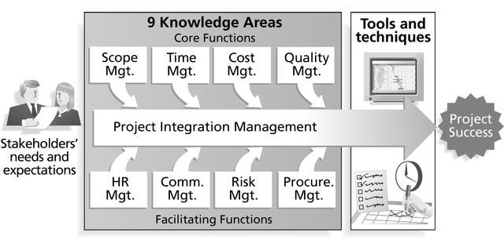

Slide 12
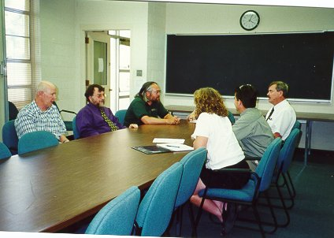




Slide 13
Relationship to other disciplines - similarities
General management encompasses
  Planning
  Organizing
  Leading
  Controlling
PM management functions overlap

Slide 14
Function overlap
Planning the work, schedule and budget
Organizing and staffing a team to implement the work
Controlling the project through tracking and monitoring progress against the plan
Leading people and resources so the plan is implemented and adjusted as smoothly as possible

Slide 15
Relationship to other disciplines - differences
Much of the knowledge needed to manage projects is unique or nearly unique to project management, e.g.
  Critical path analysis, and
  Work breakdown structures
Primary differences between general management and PM found in the use of specialized tools and techniques.

Slide 16
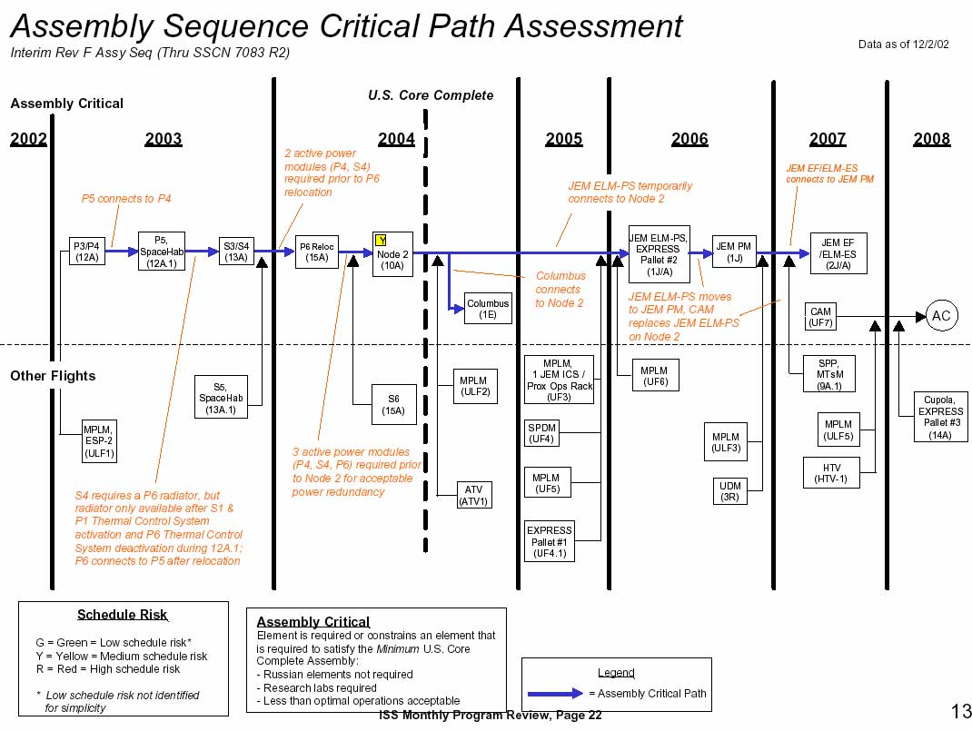

Slide 17
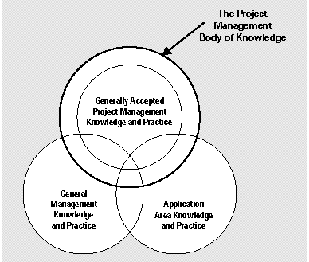
Relationship to other disciplines

Slide 18
Why do you need project management techniques?
“The reason for organizing an assignment as a project is to FOCUS the responsibility, authority, and scheduling of the project in order to meet defined goals.”
  schedule
  cost
  performance (quality)

Slide 19
Other major reasons to use PM techniques
Clear work descriptions minimize surprises and conflicts
Responsibilities and assignments for specific tasks are easily identified
Reduces need for continuous reporting
Progress can be measured against a plan
Time limits for task completion are more easily specified

Slide 20
The two types of project management activities
Project planning and definition activities
Project implementation and control activities
More simply
  Deciding, and
  Doing

Slide 21
Planning and definition activities
Definition of project goals and objectives
Definition of work requirements
Definition of quantity of work
Definition of quality of work
Definition of required resources
Definition of organization structure
Planning of task sequencing and schedule
Planning of the budget

Slide 22
Implementation and control activities
Initiating work
Monitoring and tracking progress
Comparing schedules and budgets to plans
Analyzing impact of changes and progress
Coordinating activities and people
Making adjustments to the plan as required
Completing the project
Assessing project results

Slide 23
Success factors in project management
Appropriately skilled project manager
Clear authority for the PM to act
Commitment to the PM methodology
A skilled PM team agreed to the project goals
A complete project plan that is understood by all participants
Objectives that contribute to the larger goals of the organization
Workable tracking and monitoring methods

Slide 24
Bottom line
What project management will do is provide a system for planning, documenting, organizing, and communicating.
It provides a basis for better decisions
Ultimately, it is the people who will make things happen and make things work, not the methodology!

